Slide 1


Bank of Baroda Hackathon - 2022
Technology Partner
Your Team Name : Devesh
Your team bio : Professionally working in Data Science Domain
Date : 20-09-2022

Slide 2
Problem Statement?
Why did you decide to solve this Problem statement?
Maintaing security in the Bank premises is something that is of utmost importance. The importance of the solution is solely the reason I am presenting my approach for this problem statement. Advancement in technology will surely be able to provide solution in this domain.

Slide 3
User Segment & Pain Points
Which user /advertiser segment would be early adopter of your product & why?
Surely the premises which require high survelliance will be the main target segments, as this solution will be recognizing activities in the video feed allowing officials to necessary steps in case of high alert.
The broadness and accuracy of our solution will be the USP of our product.

Slide 4
Azure tools or resources
Azure Video Indexer API- This will be the main go to tech stack for this solution as the default video indexer is already trained on object and scene detection. Along with that it also offers detecting sentiments of frame. Azure Blob Storage- As this application will be analyzing feeds realtime, it will be very important to have a good ML Data Pipeline which can be served as a backbone of storing and analyzing feed. Azure ML Services- It may be important to customize ML model, to deploy the same surely Azure ML Services will play a key role

Slide 5
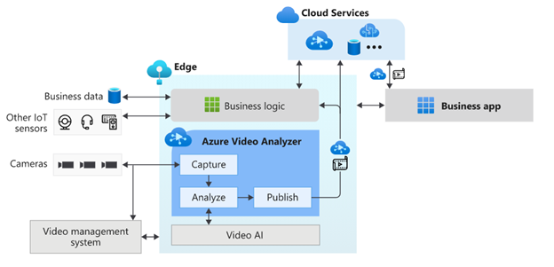
Architecture
Scene Detection and other logics

Slide 6
Key Differentiators & Adoption Plan
How is your solution better than alternatives and how do you plan to build adoption?
Looking at the granularity of the problem, key differentiator will be the accuracy and the broadness of activities we can detect in video. Along with some of our salient features will be-
Count of People- Realtime Count Of people
Time taken for activity on premises- Counting each person presence time
Identification of known facilitators- Auto detecting scene location
Feedback mechanism for false positives- Human intervention for Reinforcement Learning

Slide 7
Thank You
Devesh Chaudhary

